Slide 1
5g technology
Harshit lakhera
bca 2nd sem (morning)

Slide 2
Content
WHAT IS 5G?
EVOLUTION OF WIRELESS TECHNOLOGY
FEATURES OF 5G
BENEFITS OF 5G
FUTURE OF 5G
Challenges and Hurdles Facing 5G Technology
CONCLUSION

Slide 3
What is 5g?
5G, or fifth-generation mobile network technology, is the latest and most advanced network standard. It offers significant improvements in various aspects compared to its predecessors

Slide 4
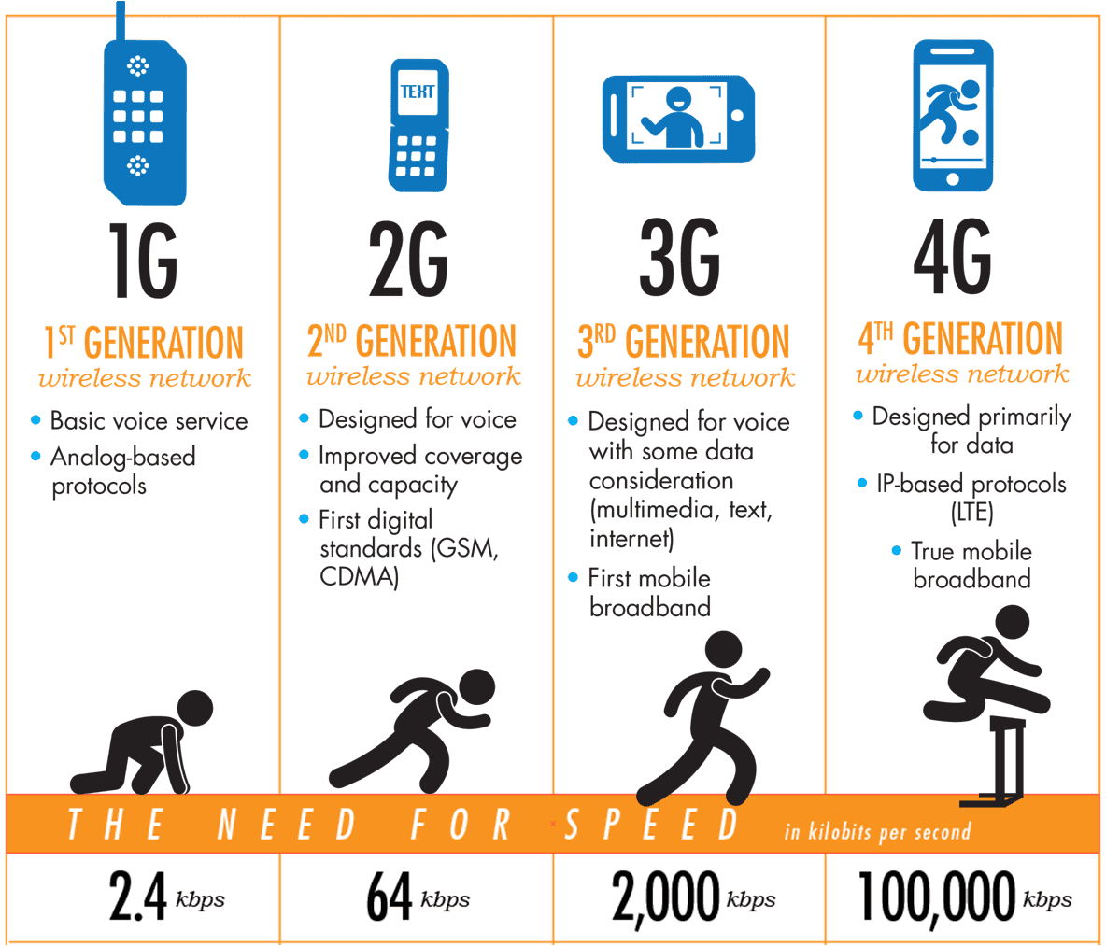
Evolution of wireless Technology

Slide 5
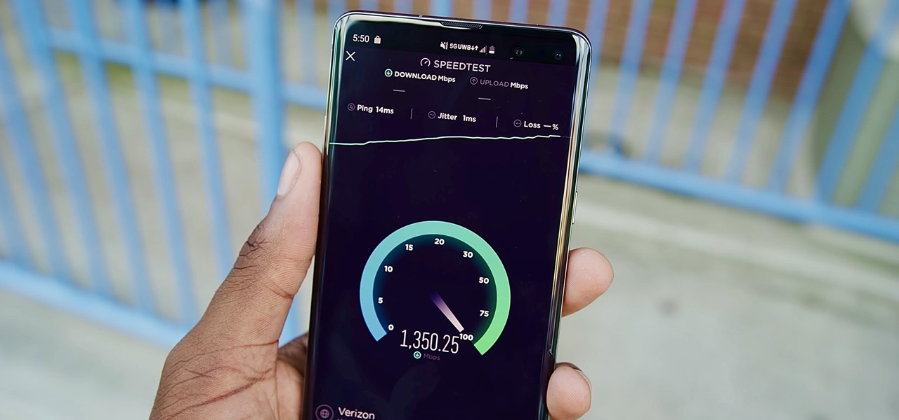
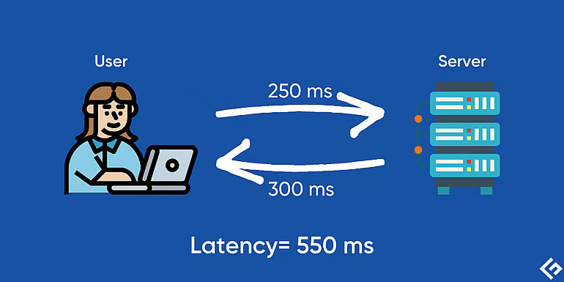
Features of 5g technology
Speed Upgrades : Each wireless network generation has reflected a significant increase in speed, 5G with its peak have speed of 20gbps which is 100x more than 4g.
Low Latency : Latency measures how long a signal takes to go from its source to its receiver, and then back again. One of the goals for each wireless generation has been to reduce latency. 5G has lowest latency with the round-trip transmission of data taking less than five milliseconds.

Slide 6
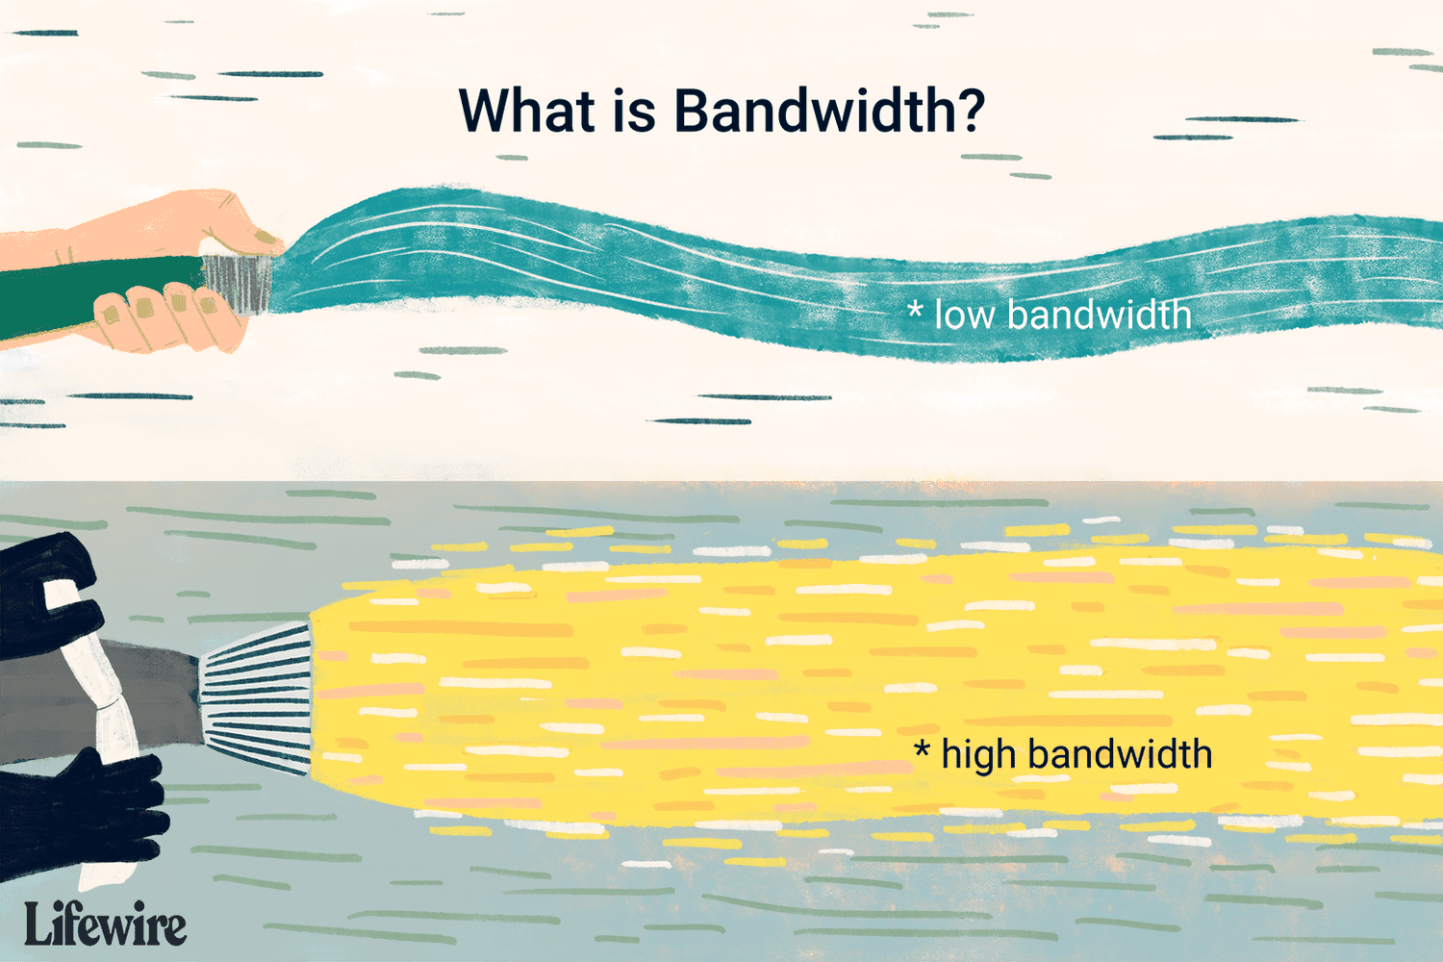
Increased Bandwidth : One of the main advantages of 5G is that it increases more bandwidth that will help transfer the data as soon as possible. Furthermore, mobile phone users can ensure a faster connection with more bandwidth after choosing a 5G network.

Slide 7


Benefits of 5G Network
High-speed network : 5G has revolutionized the experience with super speed of up to 20gbps which is equivalent to a fiber-optic Internet connection accessed wirelessly.
Entertainment and multimedia : 55 percent of mobile Internet traffic has been used for video downloads globally 5G will offer a high-definition virtual world on your mobile phone. High-speed streaming of 4K videos only takes a few seconds

Slide 8
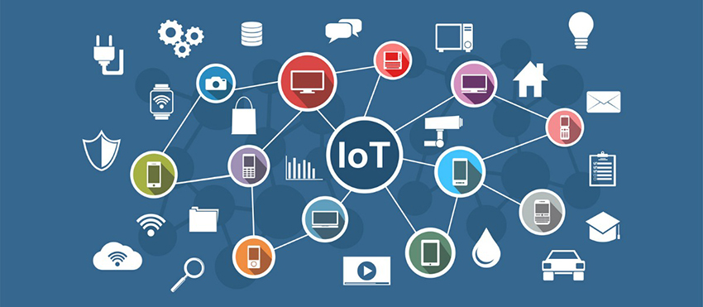

IoT Connectivity: 5G provides the infrastructure to connect a vast number of devices, facilitating the growth of smart homes, smart cities, and industrial automation.
Security and surveillance : 5G wireless technology is one of the best solutions for security and surveillance due to its higher bandwidth.

Slide 9
Future of 5G
Continued Innovation: 5G technology is still evolving, and ongoing research and development efforts are focused on further improving its capabilities, such as higher speeds, lower latency, and more efficient use of spectrum.
Industry Transformation: 5G is expected to drive digital transformation across industries, enabling new business models, enhancing productivity, and unlocking new opportunities for innovation.
5G Beyond Mobile: 5G is not limited to mobile networks but also extends to other sectors like fixed wireless access, industrial automation, and smart infrastructure.

Slide 10
Challenges and Hurdles Facing 5G Technology
Infrastructure : Building and upgrading infrastructure, including cell towers requires significant investment and The sheer number of towers and base stations needed for 5G coverage is very high.
Limited options : Currently, the selection of 5G-compatible devices, especially smartphones, is limited, particularly in the affordable segment. This hinders widespread adoption

Slide 11
Increased attack surface : The wider range of devices and applications connected through 5G raises concerns about potential vulnerabilities and security breaches

Slide 12
CONCLUSION
5G has the potential to revolutionize the way we live, work, connect, and interact with the world around us. The future of connectivity is bright, and 5G is leading the charge.

Slide 13
Thank you

